Slide 1
Generalized Window Advertising for TCP Congestion Control
Esha Desai
USC ID: 6993245898

Slide 2
GWA-TCP
Compared with traditional TCP,RED,ECN,BA-TCP (Bandwidth Aware TCP)
Introduced to overcome the congestion problems in traditional TCP
Avoids window oscillations & related fluctuations in offered load and network performance

Slide 3
Comparison
In a LAN, any GWA algorithm ensures perfect fairness and full utilization even with small router buffer size
GWA and ECN maximum packet delays are in the millisecond range, while Drop Tail and RED delays are in the range of seconds
GWA-TCP needs large buffers for full link utilization. BA-TCP removes this limitation. Buffer occupancy is ZERO during stable operation due to Tx Window Bounding.
Buffer occupancy with BA-TCP is close to zero.

Slide 4
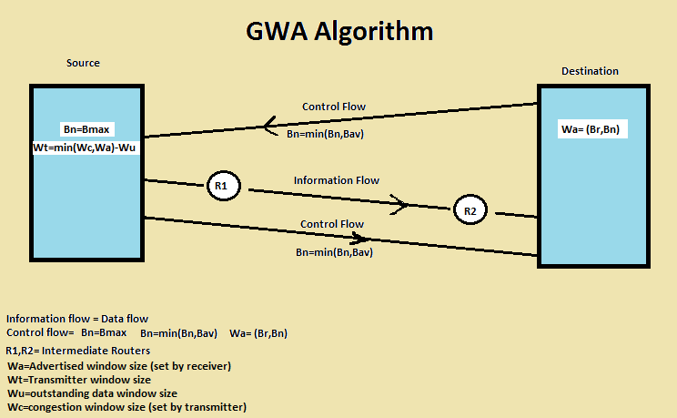
GWA Algorithm Deployment

Slide 5
Question
How did BA-TCP & GWA-TCP solve major drawbacks of traditional TCP?
Traditional TCP based on congestion recovery. It does not aim to increase offered load to force another congestion event. It does not aim to avoid packet loss.
Drawback resolved by: Co-operation between IP network entities (routers) and host based TCP entities. The routers notify the end hosts of the bandwidth capacity of path at the START of connection. Hence, packet loss is avoided right from the start.
Guarantee of a loss free operation as predicted by theory. Throughput performance depends on propagation delays and router buffer size; in typical operating conditions, GWA ensures full link utilization.

